Slide 1
Introduction to Parallel Processing
115/11/08
Part-I

Slide 2
Preface
It has allowed hardware performance to continue its exponential growth. This trend is expected to continue in the near future.
It has led to unprecedented hardware complexity and almost intolerable development costs.
In computer designers' quest for user-friendliness, compactness, simplicity, high per­formance, low cost, and low power, parallel processing plays a key role.
  High-performance uniprocessors are becoming increasingly complex, expensive, and power-hungry.
115/11/08
Part-I

Slide 3
Introduction to Parallelism
WHY PARALLEL PROCESSING?
  In the past two decades, the performance of microprocessors has enjoyed an exponential growth. (a factor of 2 every 18 months, Moore's law)
    Increase in complexity of VLSI chips
    Introduction of, and improvements in, architectural features
  Moore's law seems to hold regardless of how one measures processor performance: counting the number of executed instructions per second (IPS), counting the number of floating-point operations per second (FLOPS), or using sophisticated benchmark suites that attempt to measure the processor's performance on real applications.
115/11/08
Part-I

Slide 4
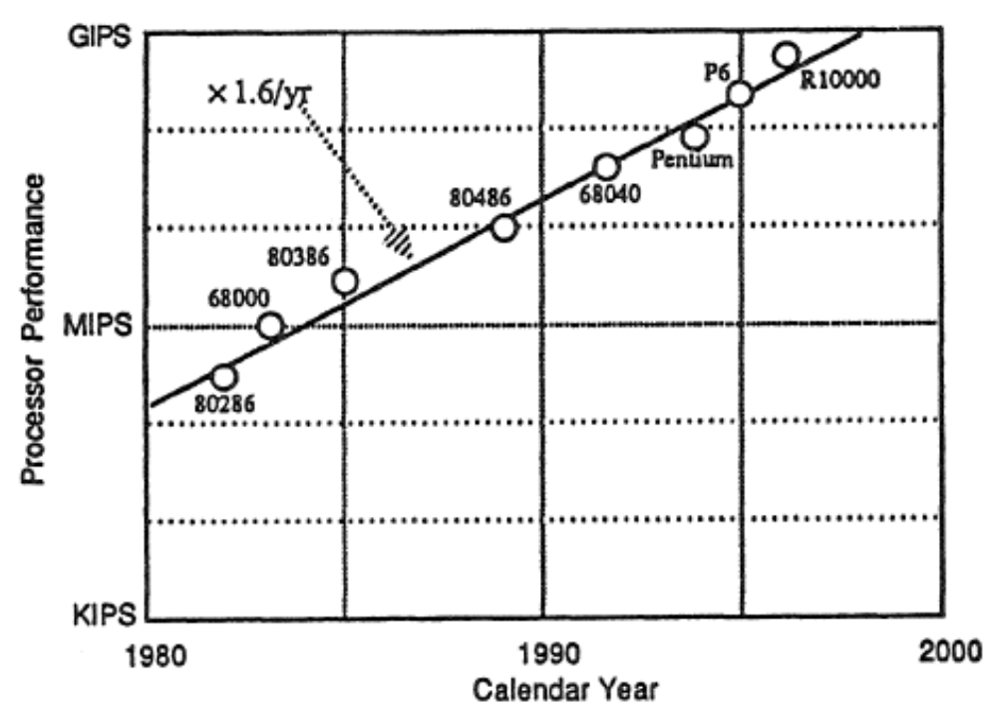
115/11/08
Part-I

Slide 5
WHY PARALLEL PROCESSING? (cont’d)
physical laws
  The most easily understood physical limit is that imposed by the finite speed of signal propagation along a wire. This is sometimes referred to as the speed-of-light argument.
  pipelining and memory-latency-hiding techniques.
  The speed-of-light argument suggests that once the above limit has been reached, the only path to improved performance is the use of multiple processors. (the same argument can be invoked to conclude that any parallel processor)
115/11/08
Part-I

Slide 6
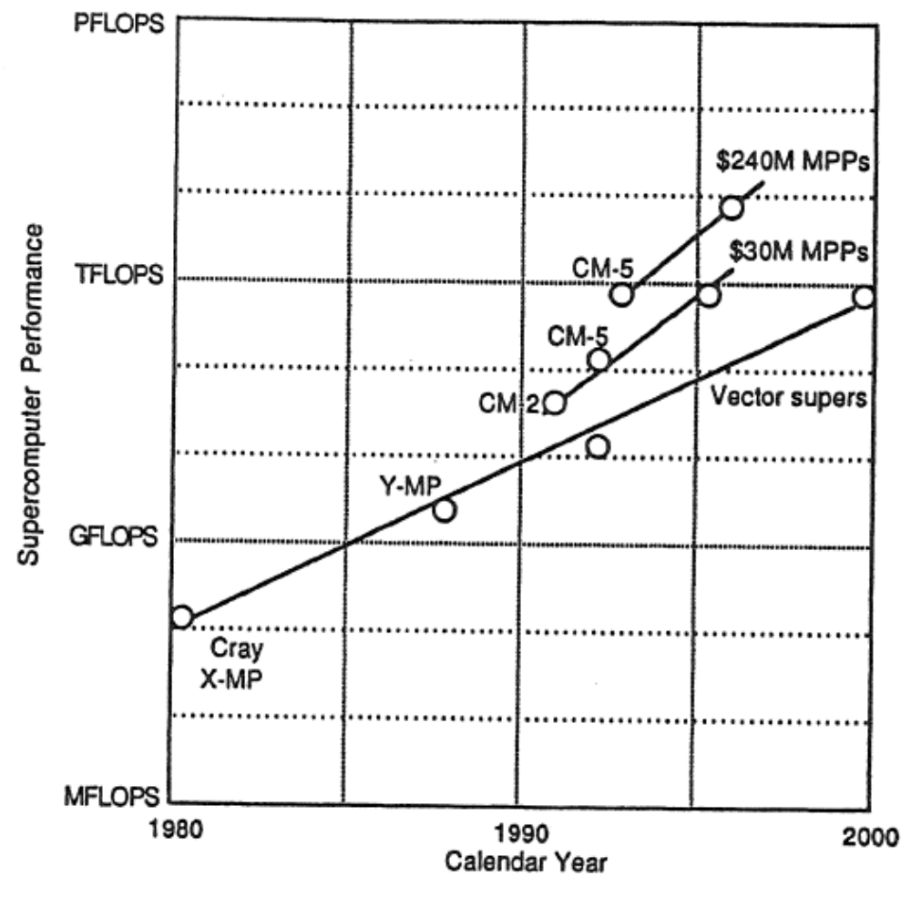
115/11/08
Part-I

Slide 7
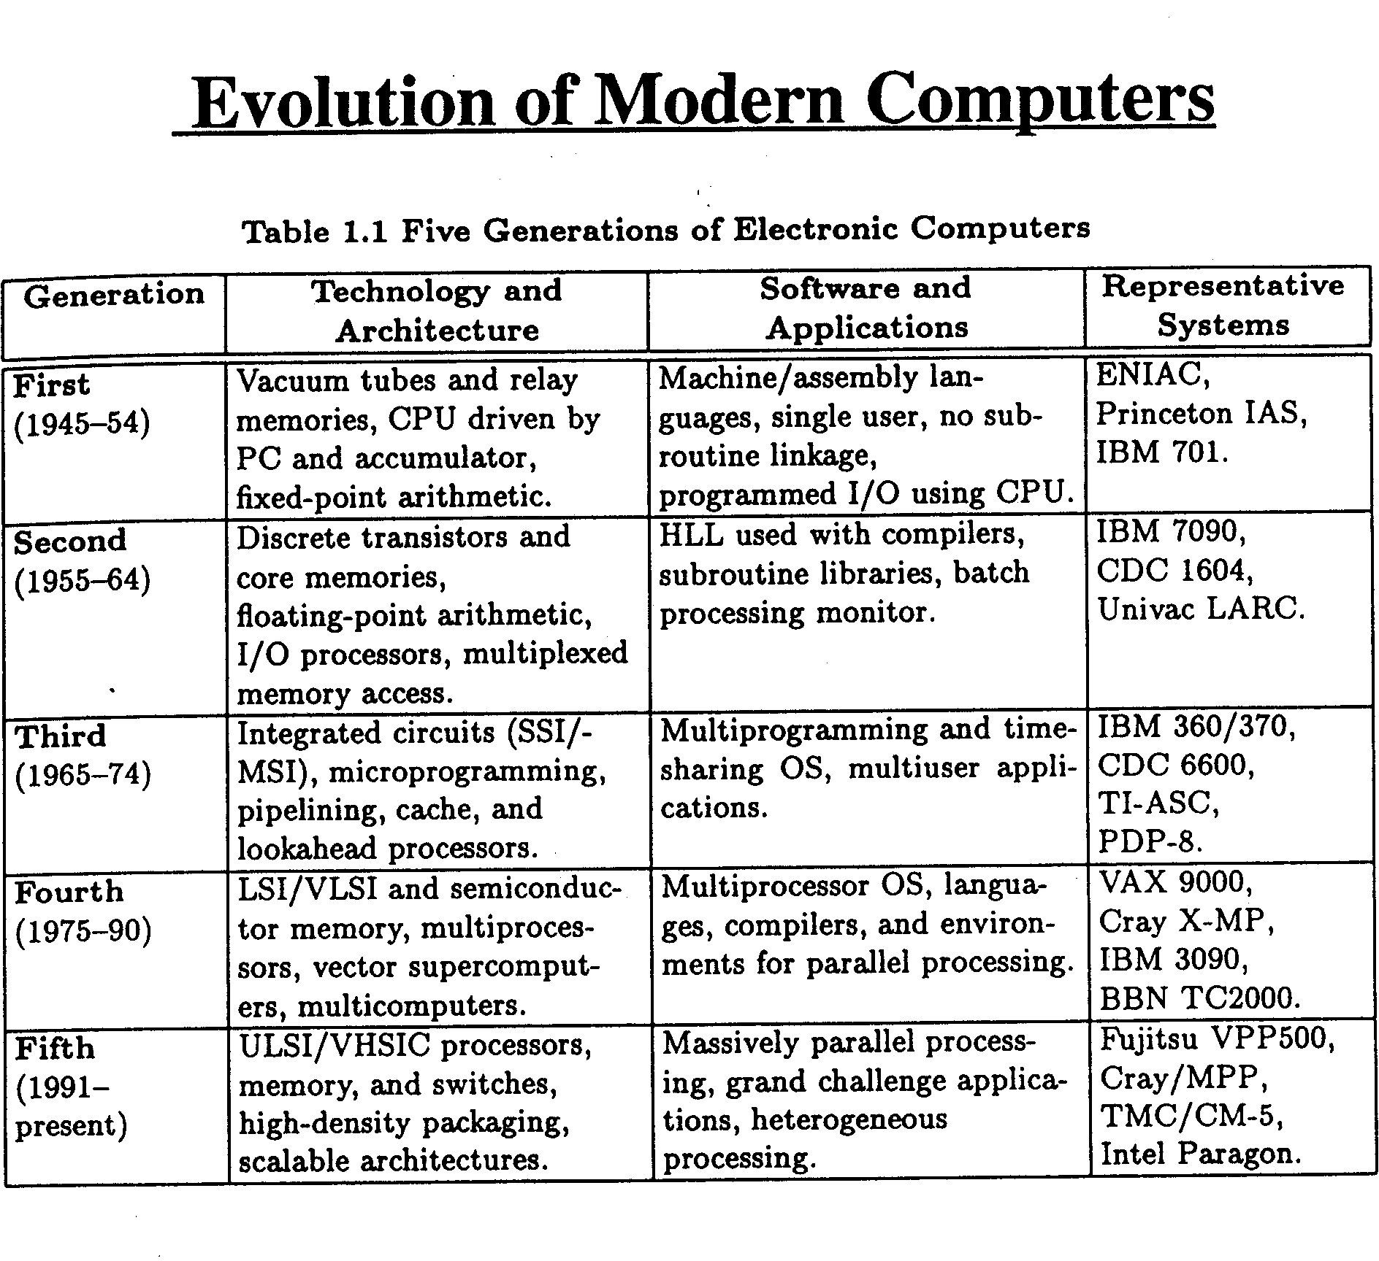
115/11/08
Part-I

Slide 8
WHY PARALLEL PROCESSING? (cont’d)
Who needs supercomputers with TFLOPS or PFLOPS performance?
The motivations for parallel processing can be summarized as follows:
  Higher speed, or solving problems faster.
  Higher throughput, or solving more instances of given problems.
  Higher computational power, or solving larger problems.
speed-up factor
This book focuses on the interplay of architectural and algorithmic speed-up techniques.
115/11/08
Part-I

Slide 9
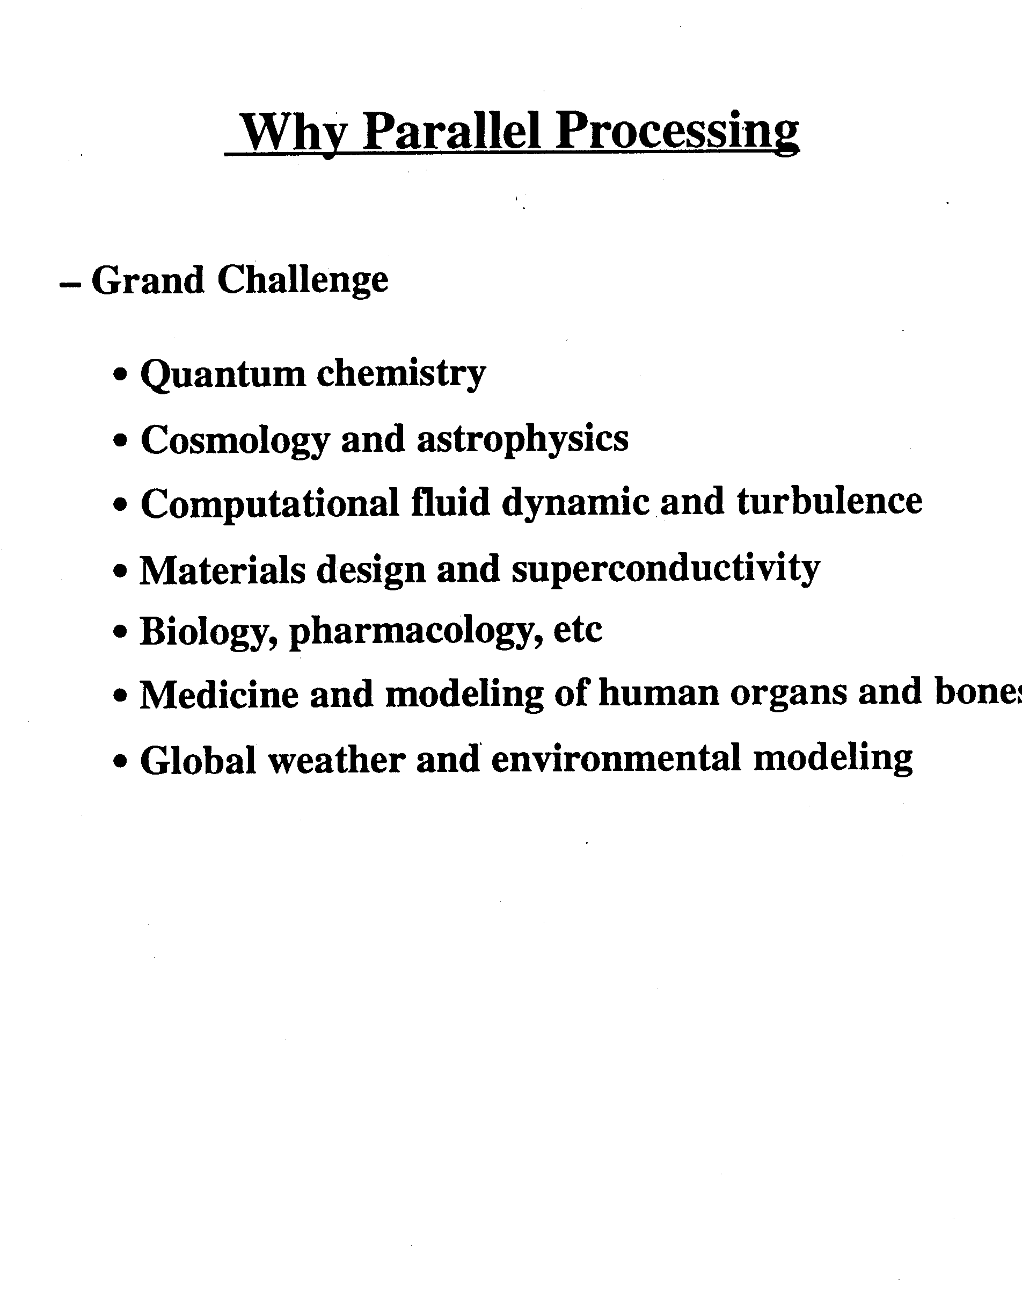
115/11/08
Part-I

Slide 10
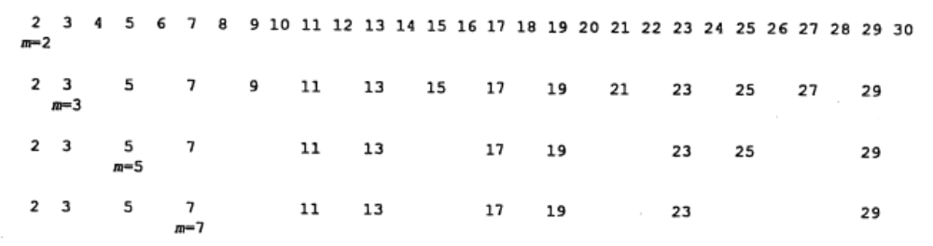
A MOTIVATING EXAMPLE
A major issue in devising a parallel algorithm for a given problem is the way in which the computational load is divided between the multiple processors.
Problem: Prime number finding
115/11/08
Part-I

Slide 11
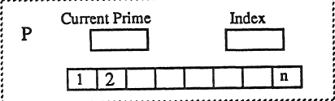
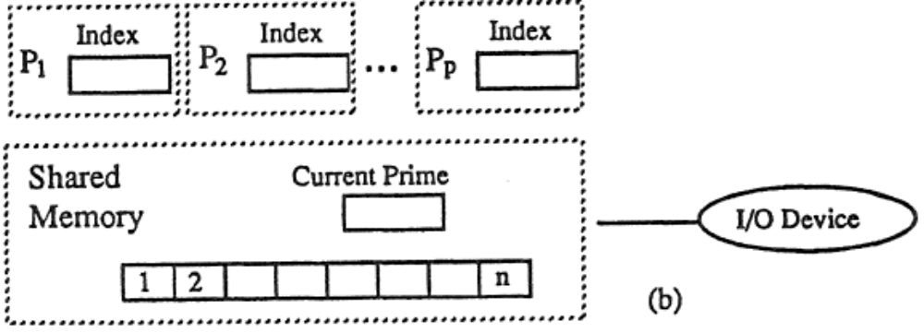
Prime number finding
Single Processor
Multiprocessors (a possible solution, share memory)
115/11/08
Part-I

Slide 12
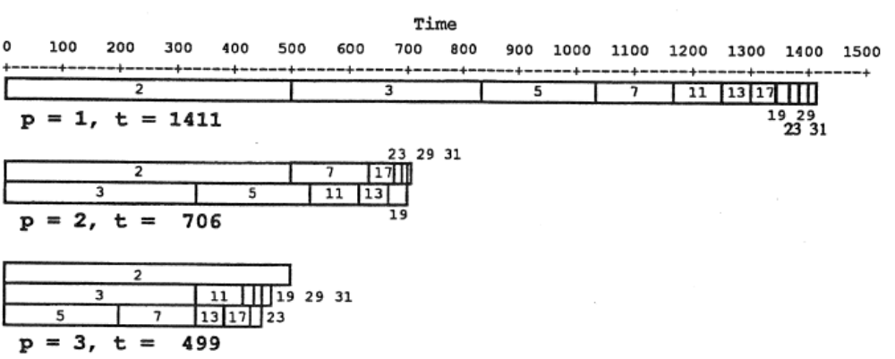
115/11/08
Part-I

Slide 13
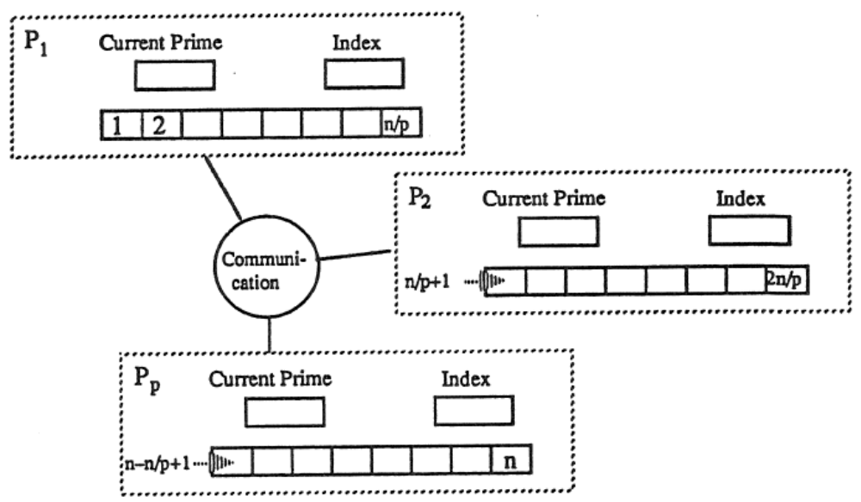
Prime number finding (cont’d.)
Multiprocessors (data parallel approach, distributed memory)
115/11/08
Part-I

Slide 14
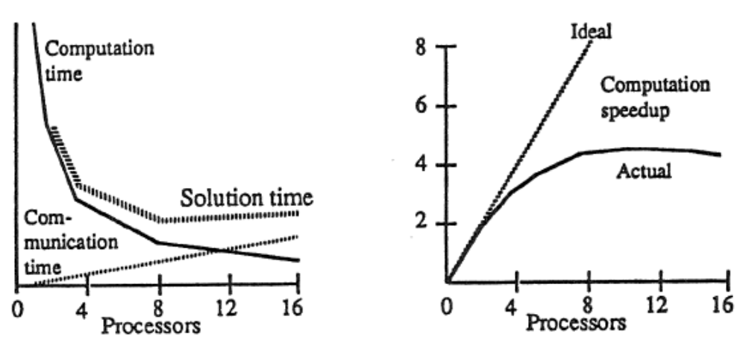
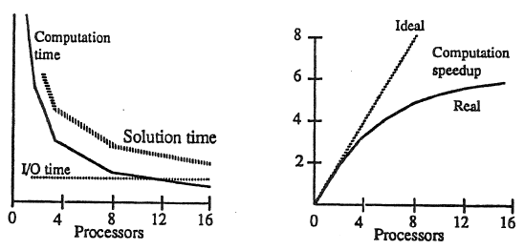
115/11/08
Part-I

Slide 15
PARALLEL PROCESSING UPS AND DOWNS
Parallel processing, in the literal sense of the term, is used in virtually every modern computer.
  overlap between instruction preparation and execution in a pipelined processor.
  multiple functional units
  multitasking
  very-long-instruction-word (VLIW) computers
In this book, the term parallel processing is used in a restricted sense of having multiple (usually identical) processors for the main computation and not for the I/O or other peripheral activities.
115/11/08
Part-I

Slide 16
The history of parallel processing
The history of parallel processing has had its ups and downs with what appears to be a 20-year cycle.
  commercial
115/11/08
Part-I

Slide 17
TYPES OF PARALLELISM: A TAXONOMY
Parallel computers can be divided into two main categories of control flow and data flow.
  Control-flow parallel computers are essentially based on the same principles as the sequential or von Neumann computer.
  Data-flow parallel computers, sometimes referred to as "non-von Neumann“ (DNA computer)
In 1966, M. 1. Flynn proposed a four-way classification of computer systems based on the notions of instruction streams and data streams.
115/11/08
Part-I

Slide 18
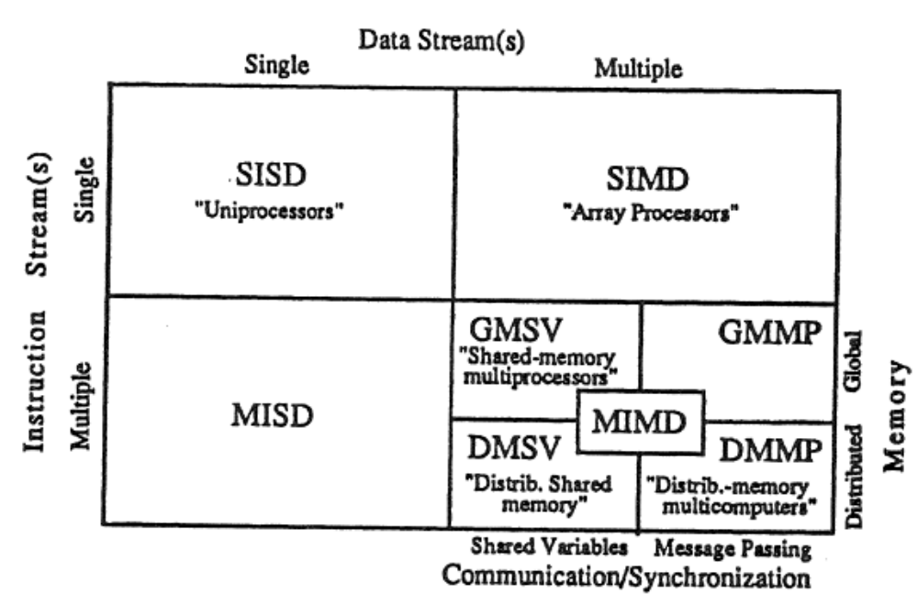
115/11/08
Part-I

Slide 19
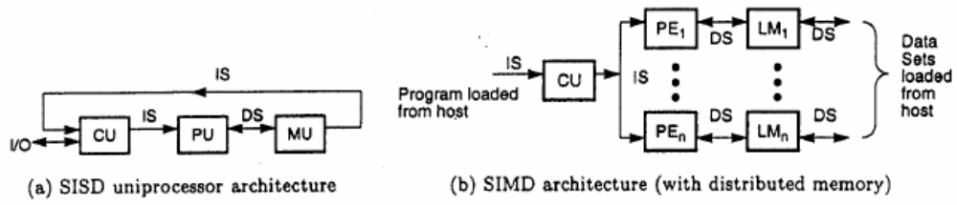
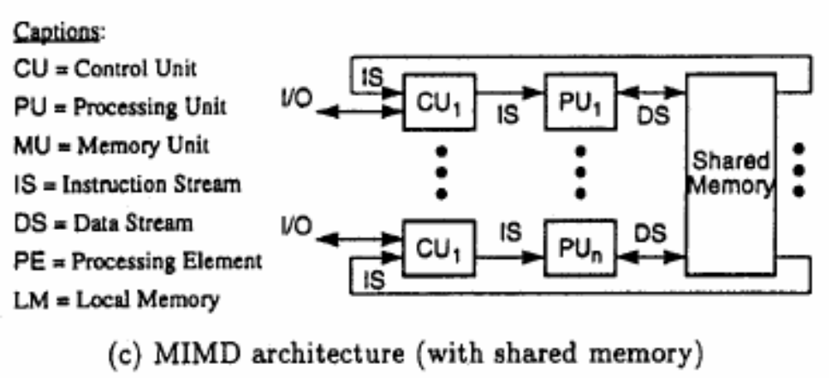
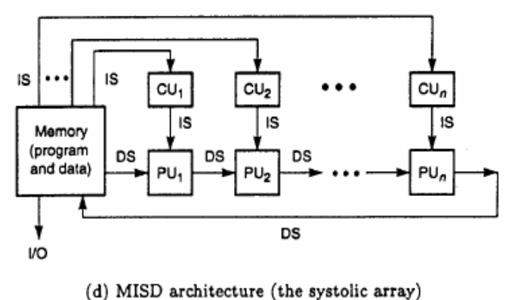
115/11/08
Part-I

Slide 20
Flynn classification
The MIMD category includes a wide class of computers. For this reason, in 1988, E. E. Johnson proposed a further classification of such machines based on their
  memory structure (global or distributed) and
  the mechanism used for communication/synchronization (shared variables or message passing).
SPMD and MPMD
CISC, NUMA, PRAM, RISC, and VLIW.
115/11/08
Part-I

Slide 21
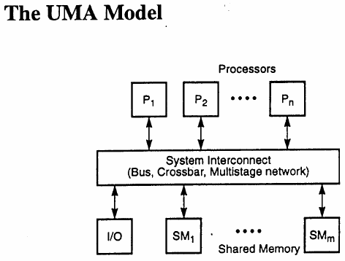
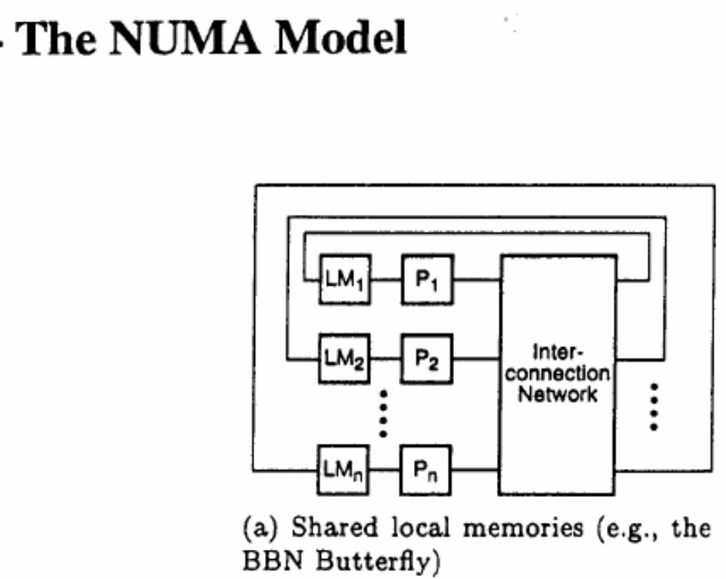
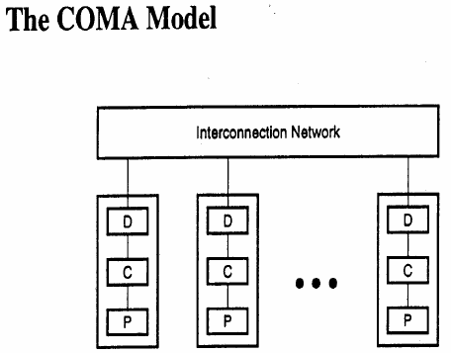
Uniform memory access
Cache only
Share memory architecture
115/11/08
Part-I

Slide 22
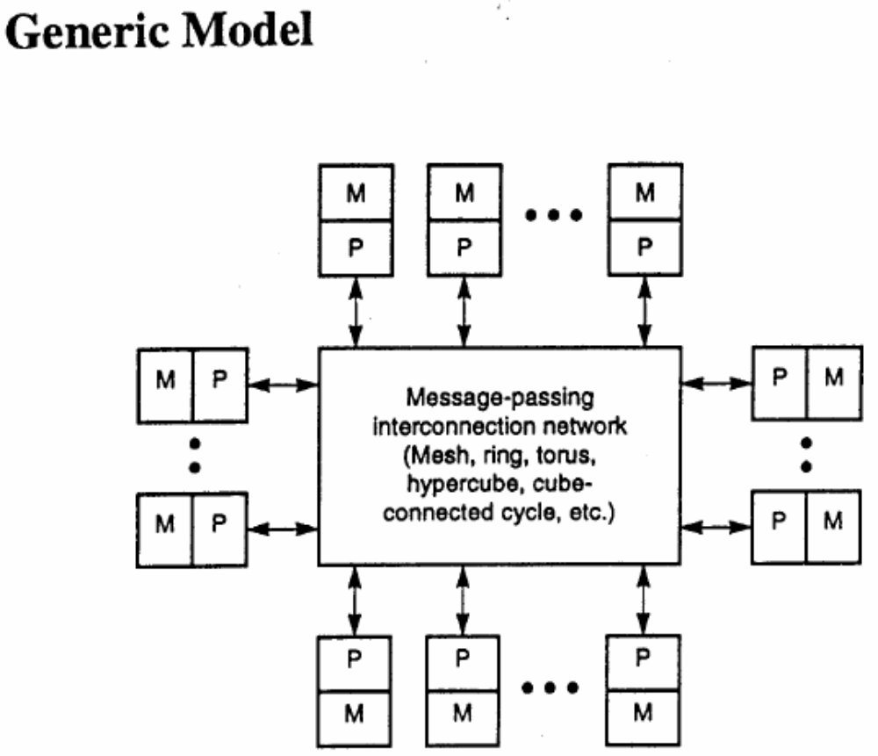
Distrusted memory architecture
115/11/08
Part-I

Slide 23
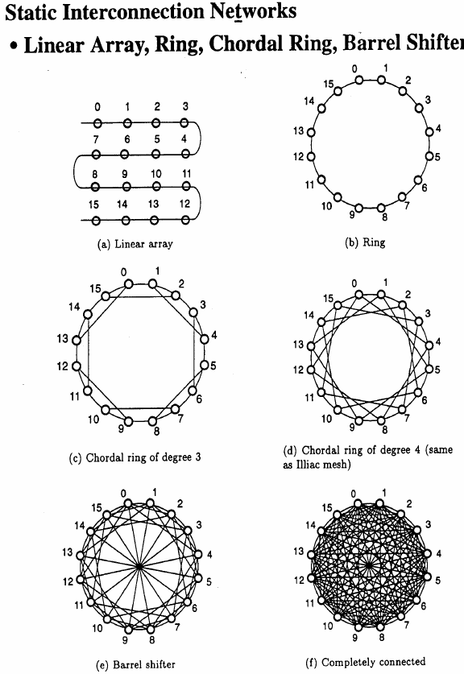
115/11/08
Part-I

Slide 24
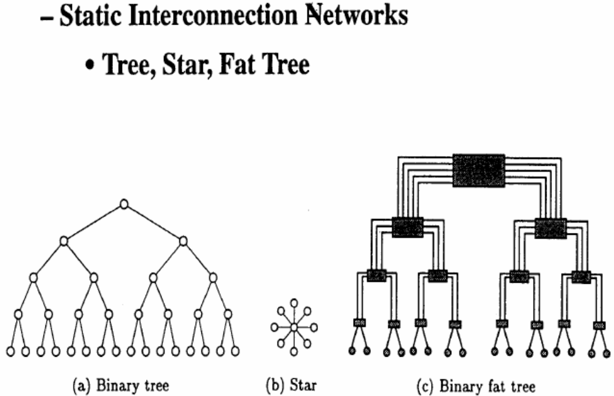
115/11/08
Part-I

Slide 25
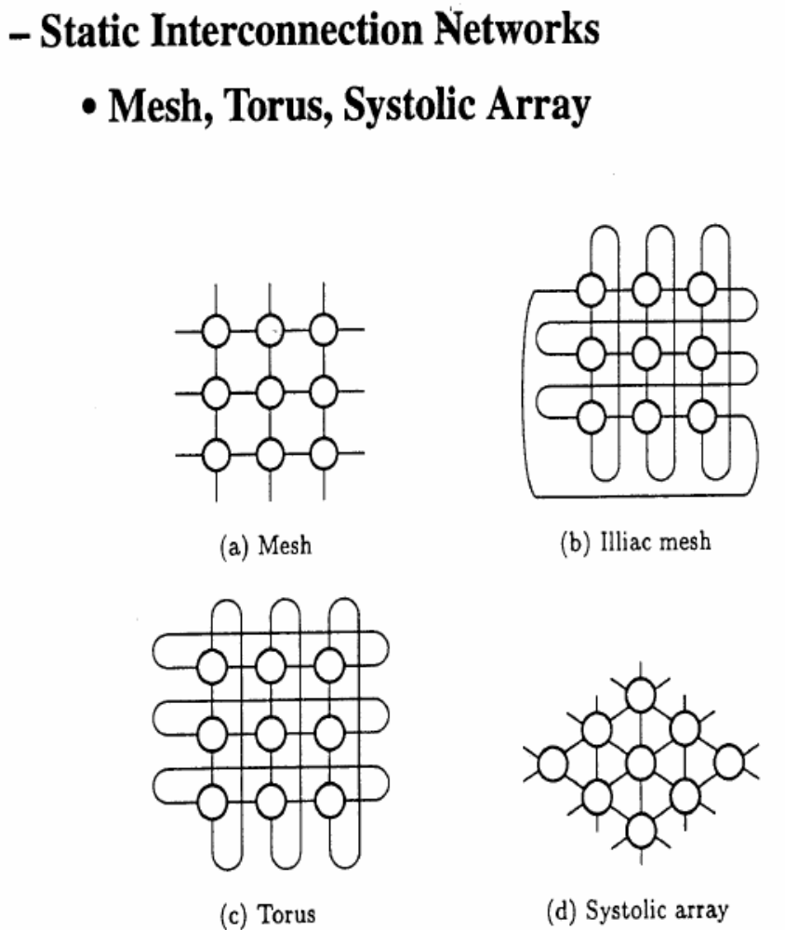
115/11/08
Part-I

Slide 26
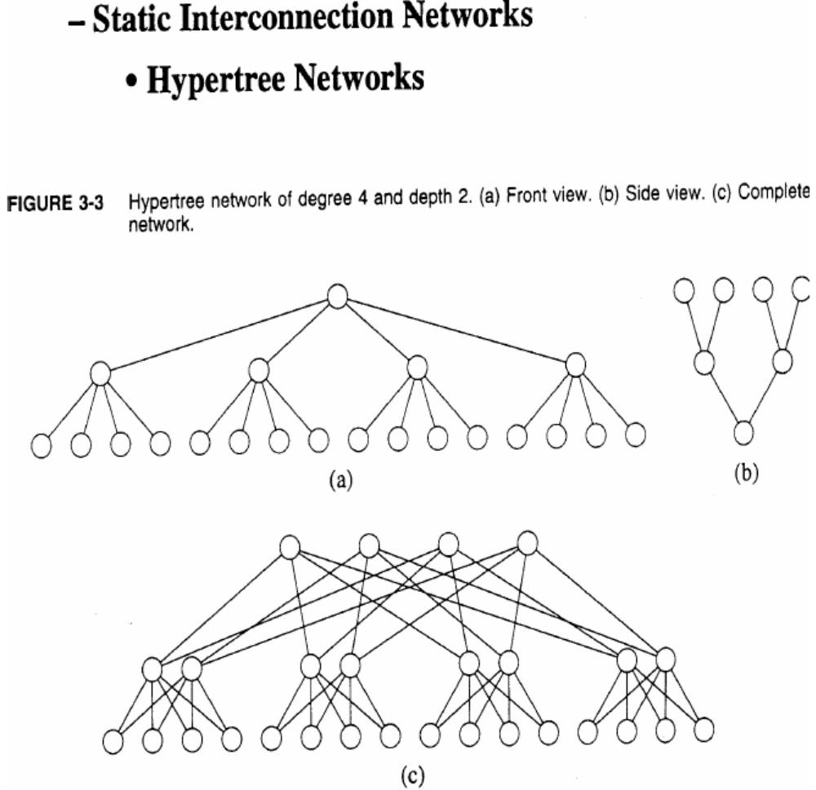
115/11/08
Part-I

Slide 27
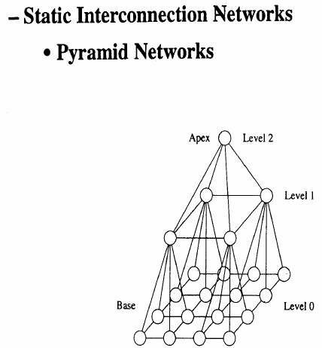
115/11/08
Part-I

Slide 28
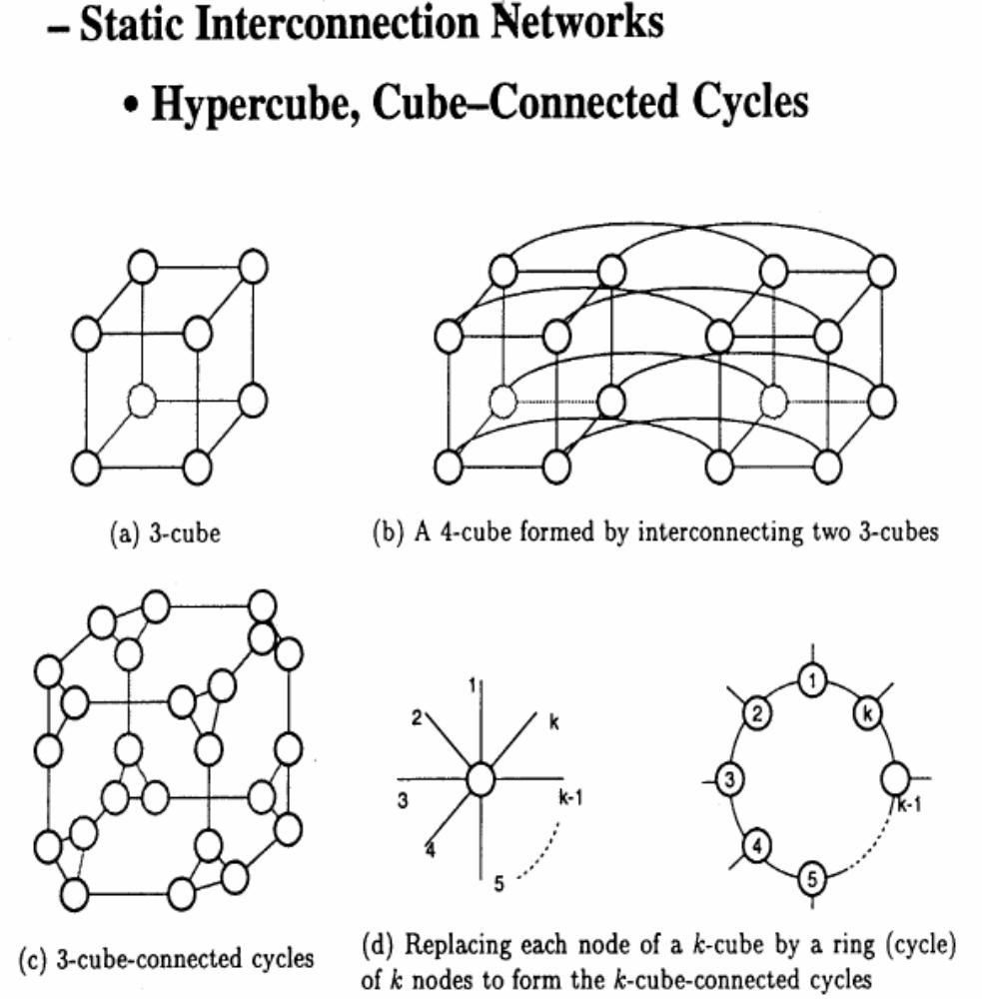
115/11/08
Part-I

Slide 29
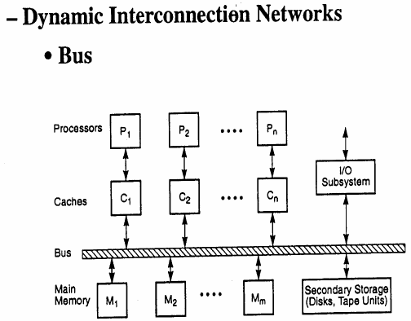
115/11/08
Part-I

Slide 30
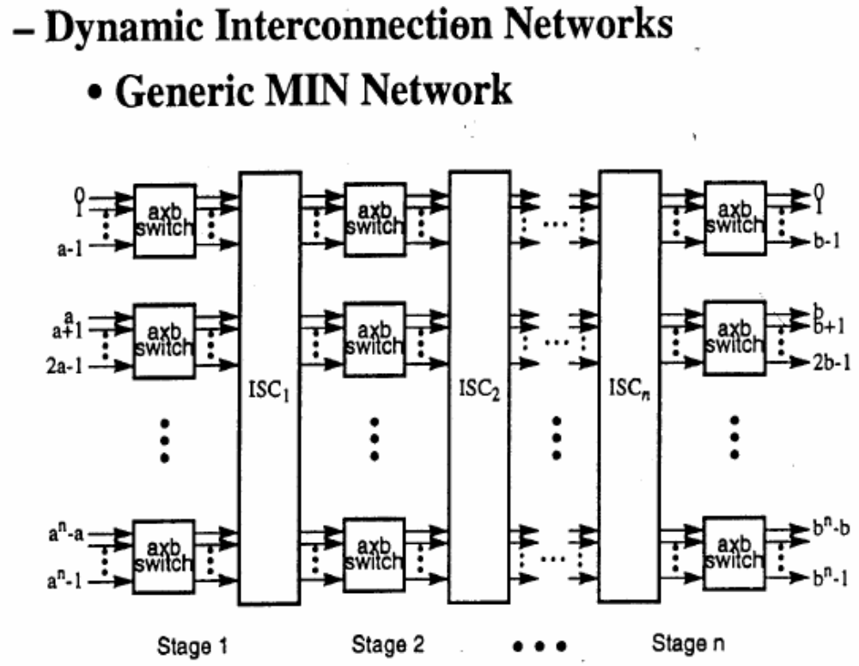
Multistage interconnection network
115/11/08
Part-I

Slide 31
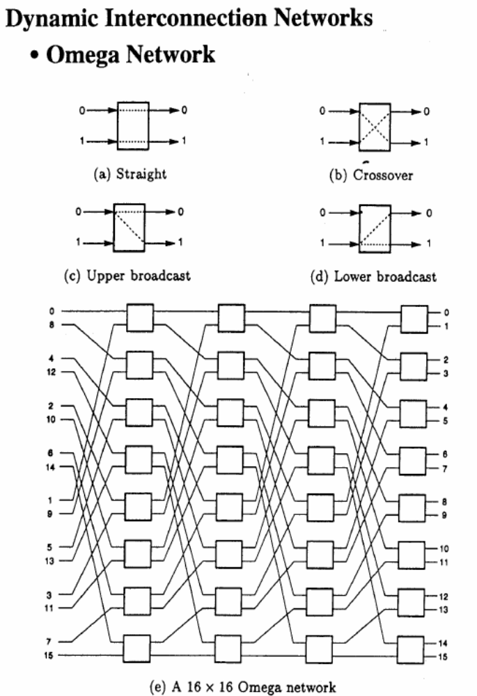
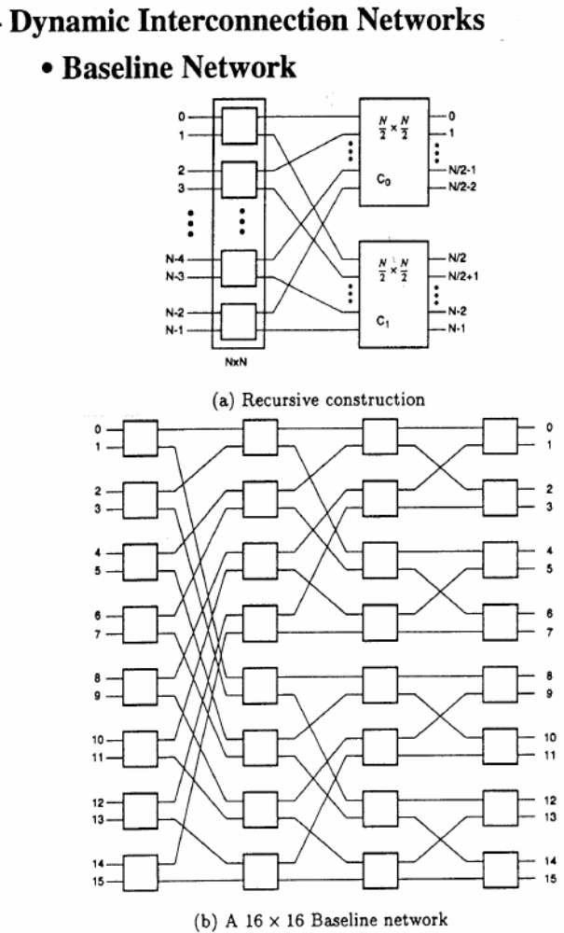
115/11/08
Part-I

Slide 32
ROADBLOCKS TO PARALLEL PROCESSING
Grosch's law (computing power is proportional to the square of cost)
Minsky's conjecture (speed-up is proportional to the logarithm of the number p of processors)
The tyranny of Ie technology (uniprocessors will be just as fast)
The tyranny of vector supercomputers (why bother with parallel processors?)
The software inertia (billions of dollars worth of existing software)
Amdahl's law
115/11/08
Part-I

Slide 33
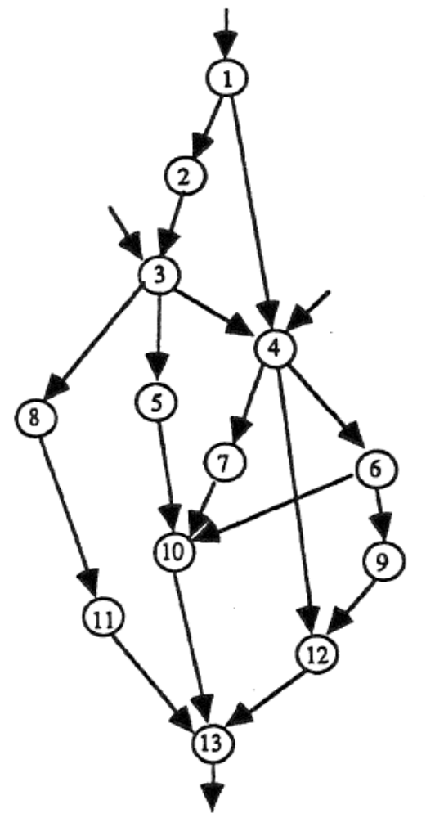
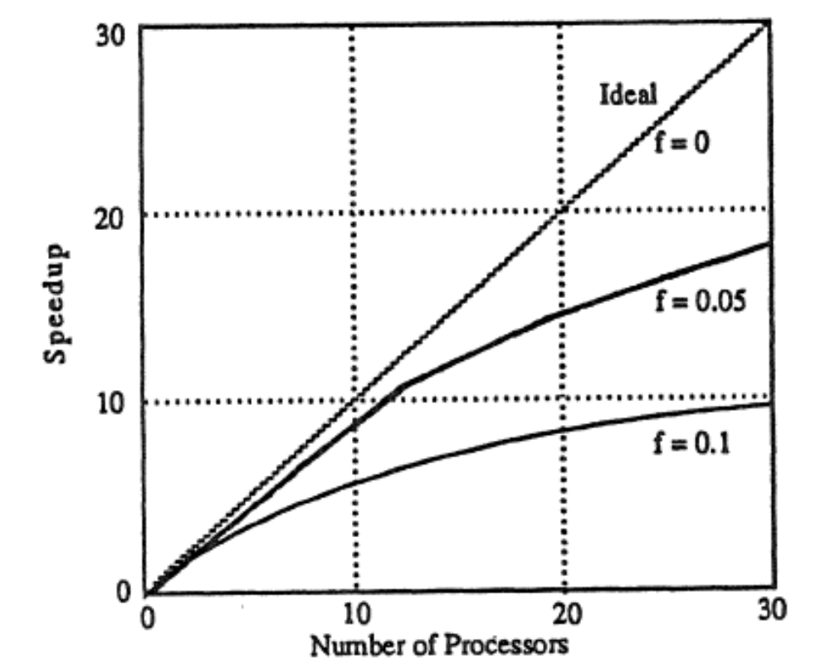
115/11/08
Part-I

Slide 34
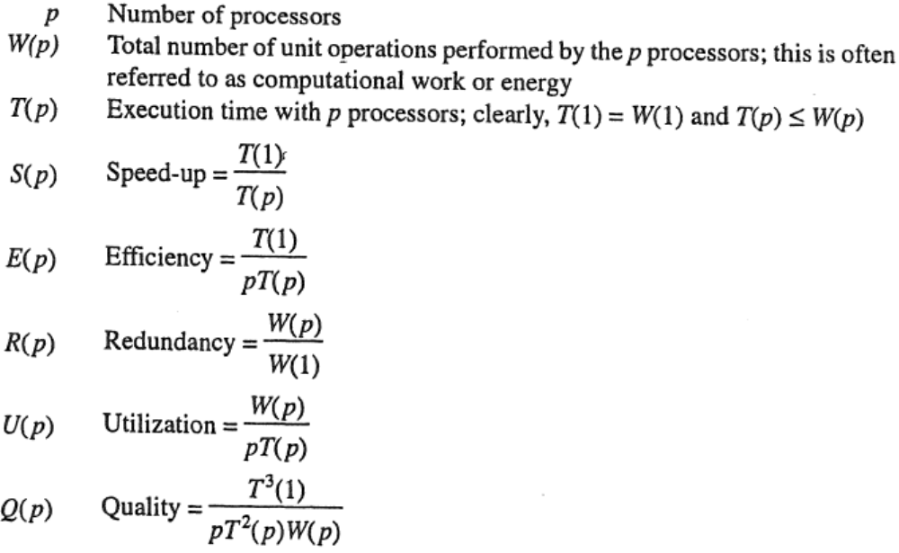

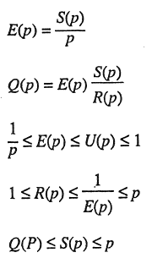
EFFECTIVENESS Of PARALLEL PROCESSING
115/11/08
Part-I

Slide 35
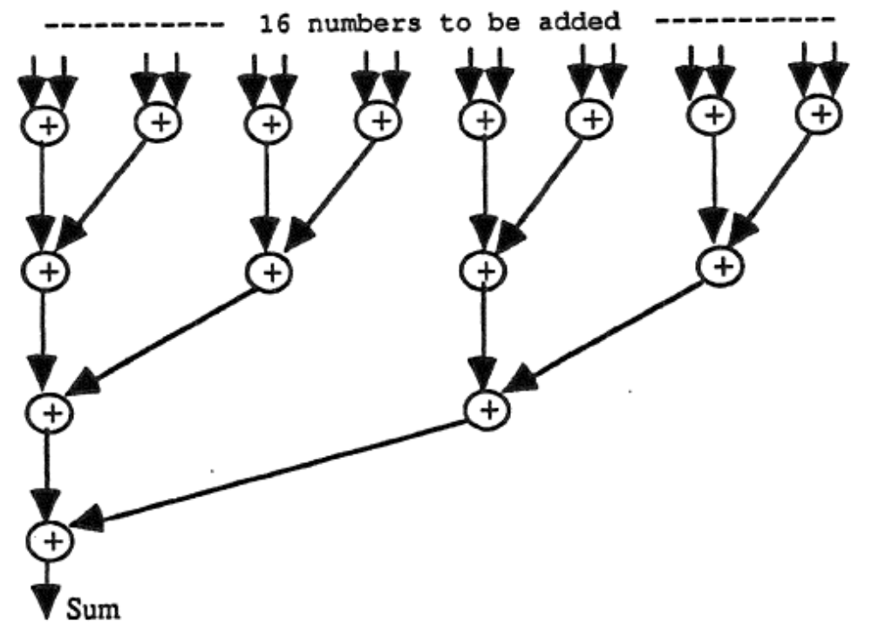
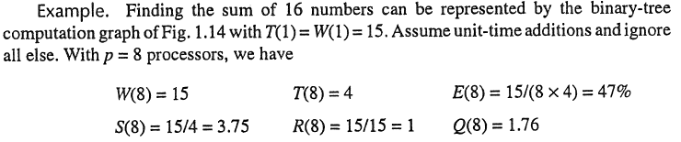
115/11/08
Part-I

